Slide 1
Annual Interagency Accessibility Forum
Unlocking the Power of Accessibility
October 11-13, 2022
Advancing Accessibility within a Small Agency
Angela Watkins and Marcelle Salley-Owens (PBGC)

Slide 2
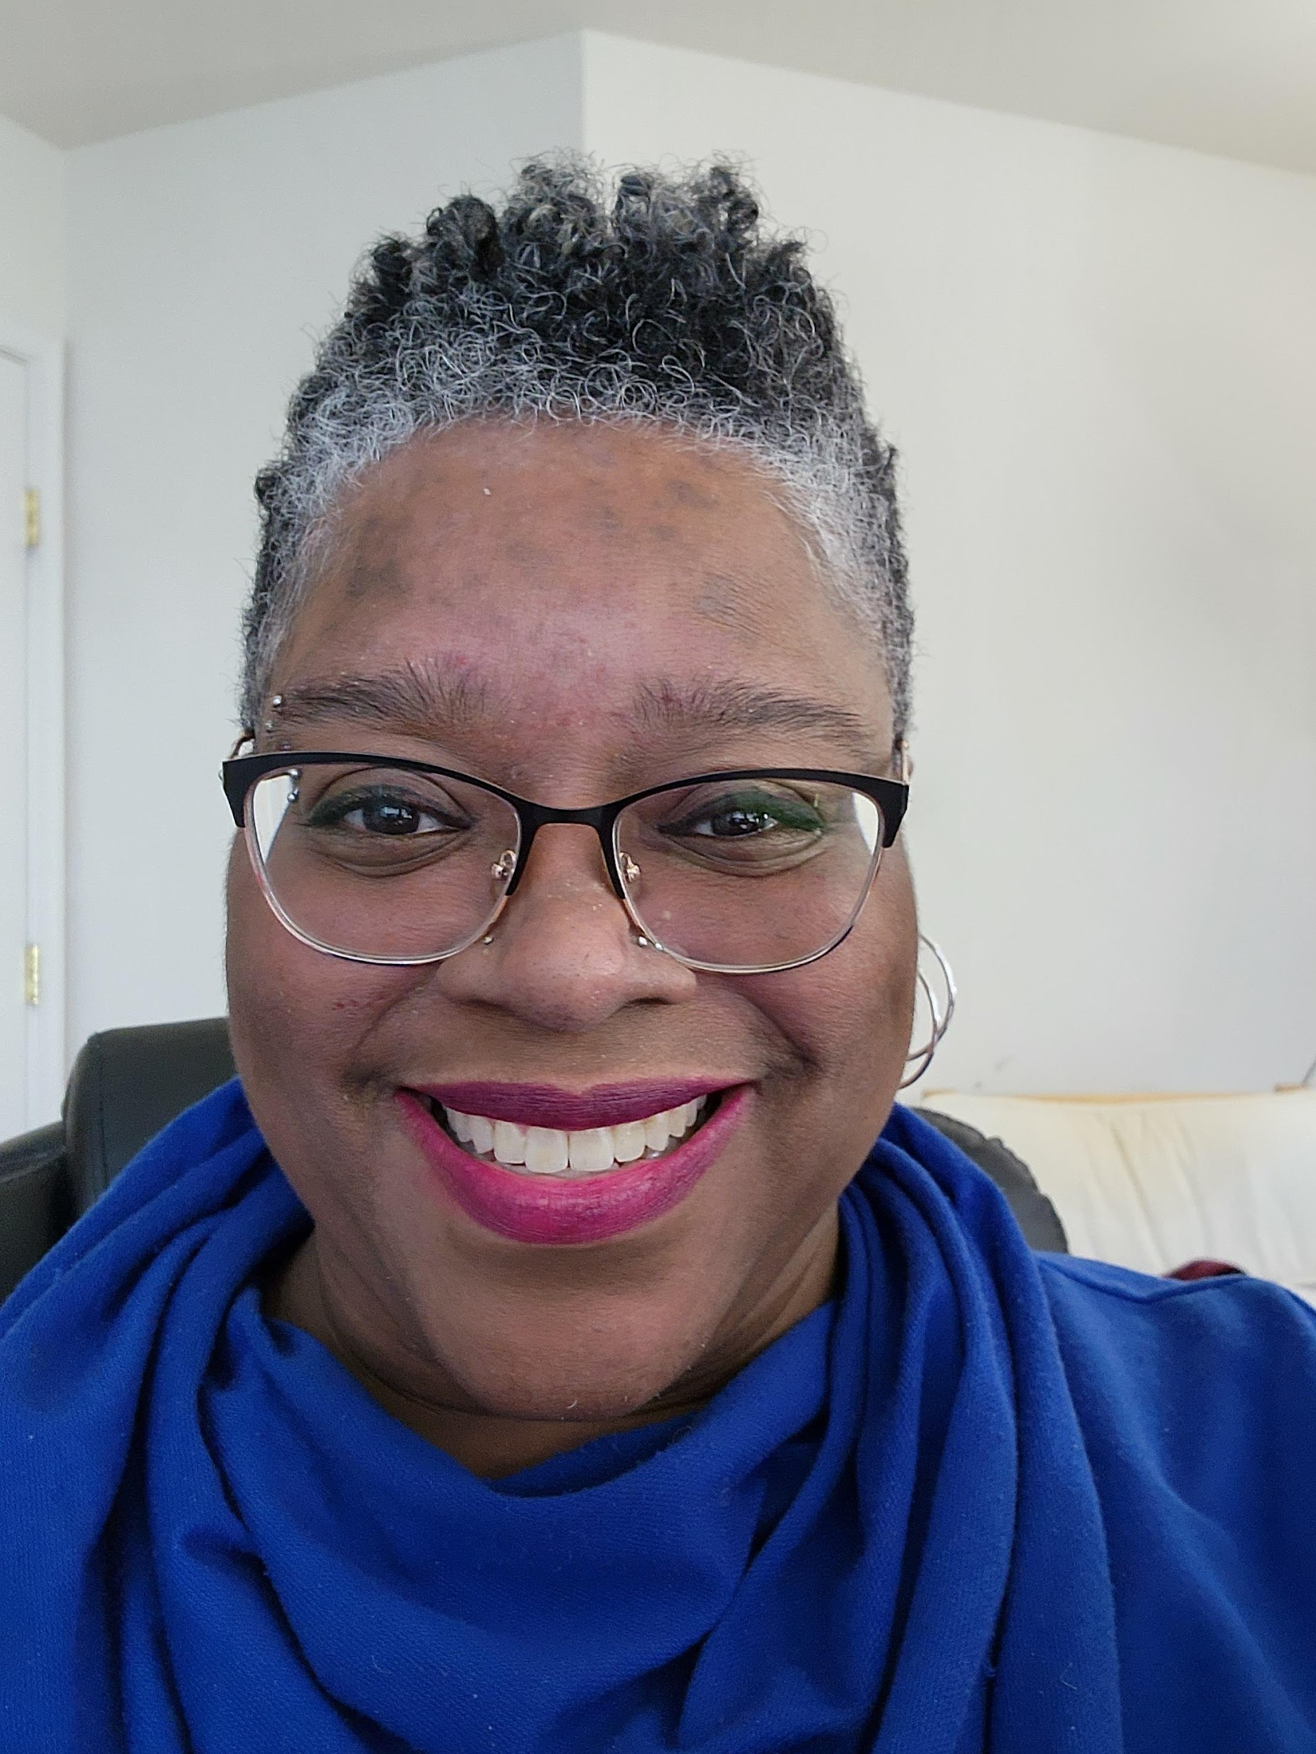
Angela Watkins, Section 508 Program Manager
I am…
Pension Benefit Guaranty Corporation (PBGC)
Office of Information Technology
Enterprise Governance Department, Policy Compliance Division
445 12th Street SW
Washington DC 20024
(202) 229-3188
Section 508 Program Manager
Anglela Watkins email: watkins.angela@pbgc.gov
Connect via Linkedin: Anggie Watkins
Notes:
Angela Watkins serves as the Section 508 Program Manager. She’s been in the position since 2018 as noted before and been involved with accessibility since 2001.

Slide 3
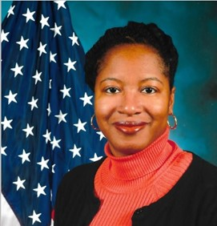
Marcelle Salley-Owens, Deputy Section 508 Program Manager
I am…
Pension Benefit Guaranty Corporation (PBGC)
Office of Information Technology
Enterprise Governance Department, Policy Compliance Division
445 12th Street SW
Washington DC 20024
(202) 229-3116
Section 508 Program Manager
Marcelle Salley-Owens email: salley-owens.marcelle@pbgc.gov
Notes:
Marcelle Salley-Owens is noted on the Section 508 Program Managers as the Back-up. Marcelle serves more as a Deputy rather than back-up. Angela and Marcelle (We) work in tandem in supporting the agency employees regarding accessibility issues.

Slide 4
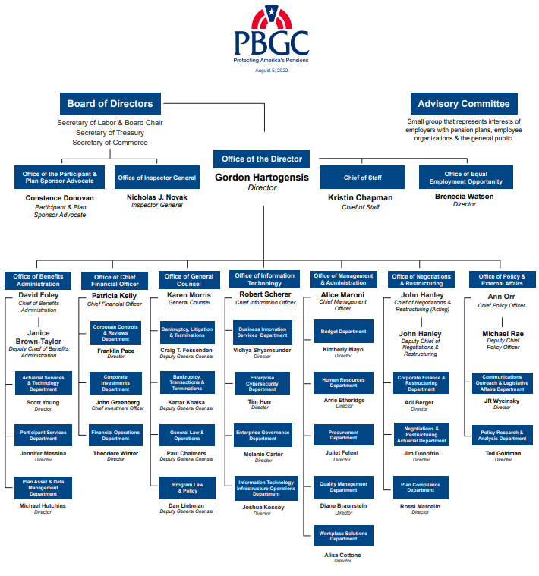
PBGC and the Section 508 Intra-Agency Compliance Team
Pension Benefit Guaranty Corporation (PBGC)
PBGC was created by the Employee Retirement Income Security Act (ERISA) of 1974
Ranked #1 in the small agency Category as “Best Places to Work in the Federal Government for 2021”
Supported by Section 508 Intra-agency Compliance Team of Federal Employees
Notes:
PBGC was created by the Employee Retirement Income Security Act of 1974 to encourage the continuation and maintenance of private sector defined benefit pension plans, provide timely and uninterrupted payment of pension benefits, and keep pension insurance premiums at a minimum
We have under 1,000 Federal Employees – which is the categorization of small agency and several hundred contractors
At PBGC we have a Section 508 Intra-Agency Compliance Team with representatives from OIT, Human Resources, EEO, Procurement, Communications, Facilities, and Legal

Slide 5
Phases of Advancing Accessibility within a Small Agency
Sharing Phases of “Advancing Accessibility”
Awareness - People learn about the topic of accessibility
Acknowledgment - People accept that accessibility is important or how it impacts them and the way they work
Adaption - People start to change their behavior about accessibility
Adoption – People’s changed behavior becomes habit when considering accessibility
Advocacy* - People help and encourage others to
adhere to accessibility, and
apply better behaviors regarding accessibility
Notes:
While our focus is in fact on what’s occurring in a small agency, this information is scalable for agencies of any size. In addition, we’re discussing lessons learned developed and focused in a small agency without a team of contract support and efforts made to ensure both federal and contractor employees understand our motto that Accessibility is Everyone’s Responsibility.

Slide 6
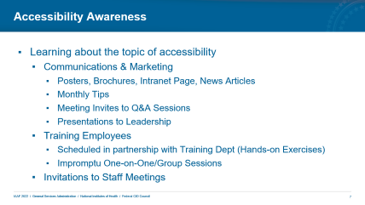
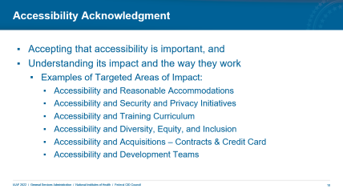
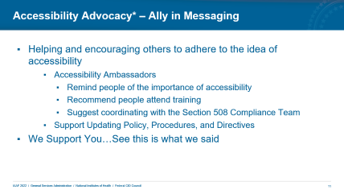
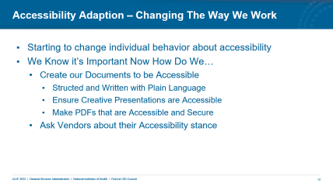
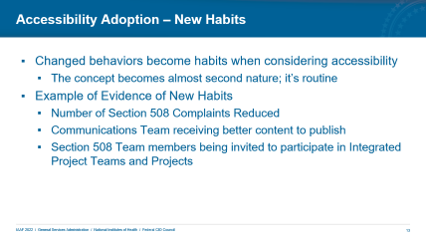
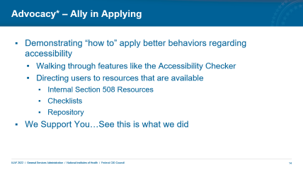
Advancing Accessibility Summary Slide
Notes:
Note: In Presentation Mode – by clicking each of the slide image

Slide 7
Accessibility Awareness
Learning about the topic of accessibility
Communications & Marketing
Posters, Brochures, Intranet Page, News Articles
Monthly Tips
Meeting Invites to Q&A Sessions
Presentations to Leadership
Training Employees
Scheduled in partnership with Training Dept (Hands-on Exercises)
Impromptu One-on-One/Group Sessions
Invitations to Staff Meetings
Notes:
https://www.section508.gov/tools/playbooks/technology-accessibility-playbook-intro/
While we’re leveraging elements from GSA’s playbook – we’re focusing on the impact what we’ve been able to accomplish and observations made along the way.
Communications & Marketing
Communications department was instrumental in ensuring messaging was comprehensive, visually appealing, and able to be distributed either via hard copy (when we were in person) or electronically when we went virtual.
We also partner with them to promote scheduled activities via the Corporate Calendar to provide additional visibility to activities.
Training
Invitations to Staff Meetings

Slide 8
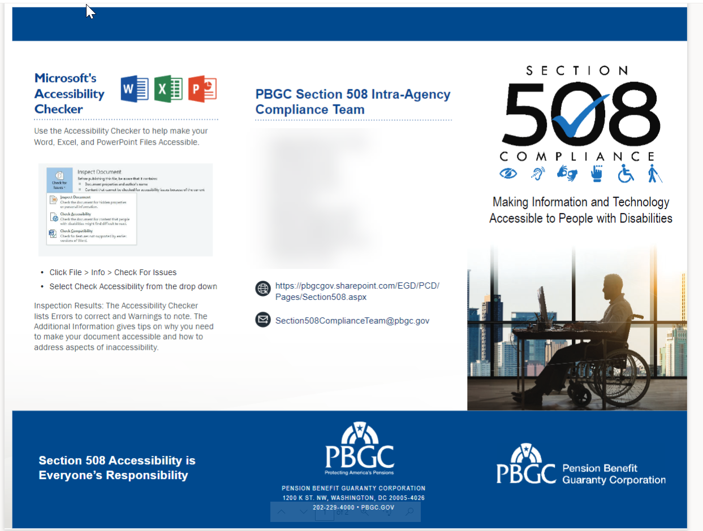
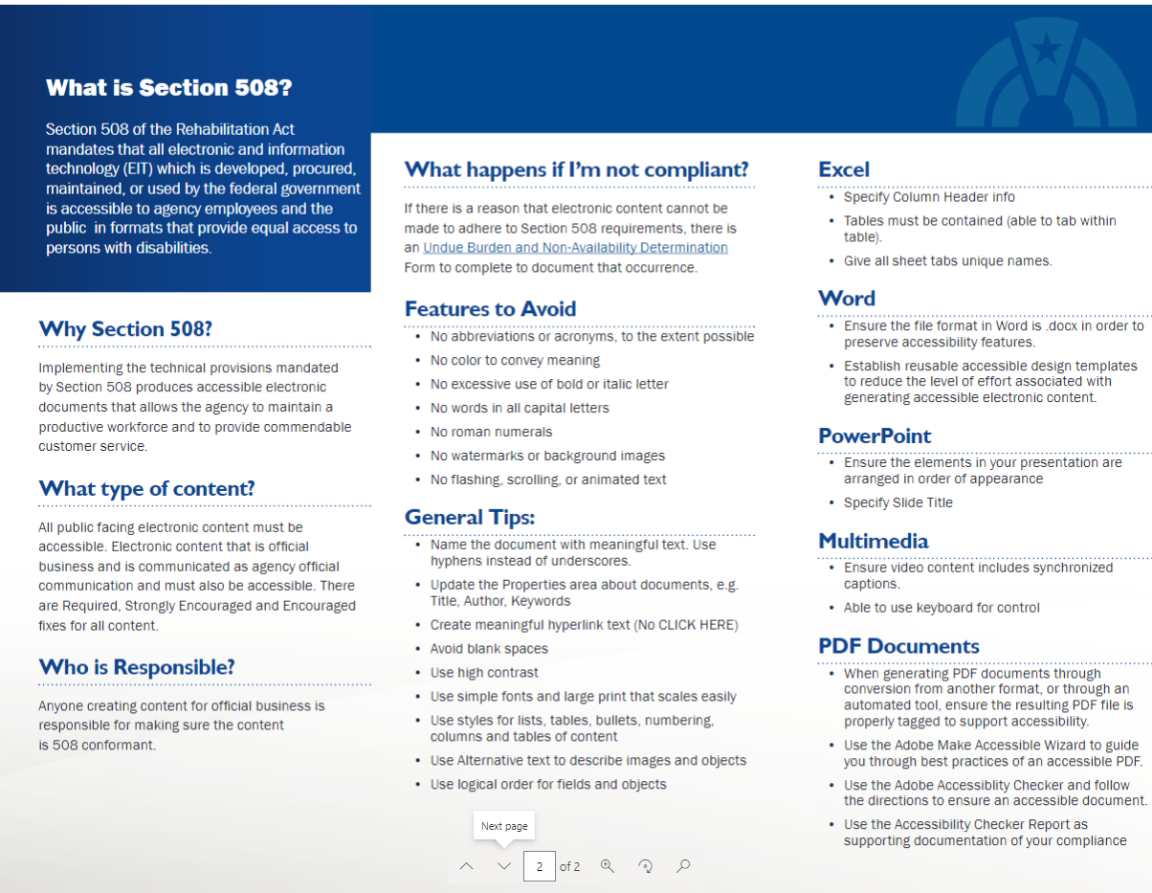
WIIFM – What’s In It For Me? – Role-based information
Brochure for the General User

Slide 9
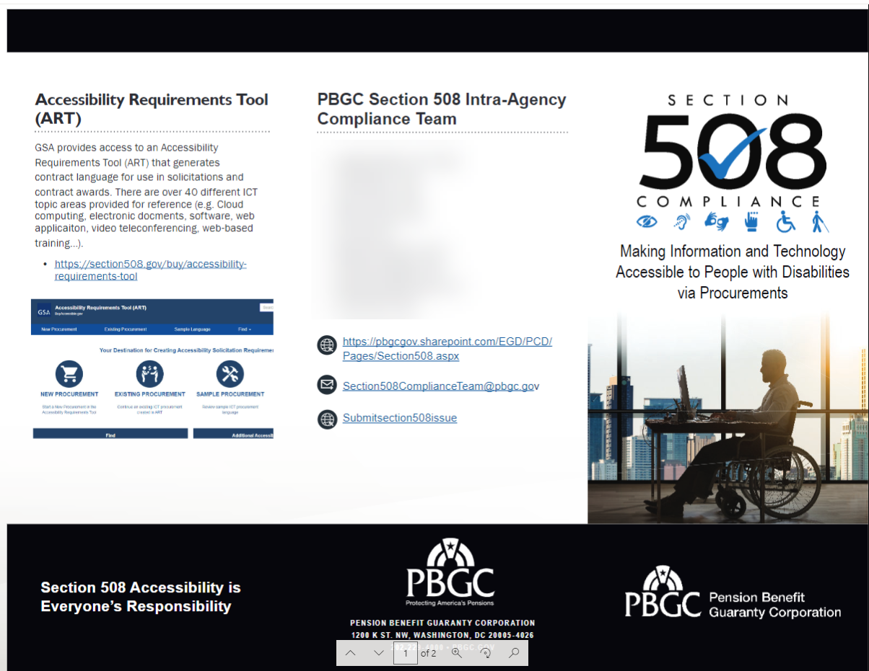
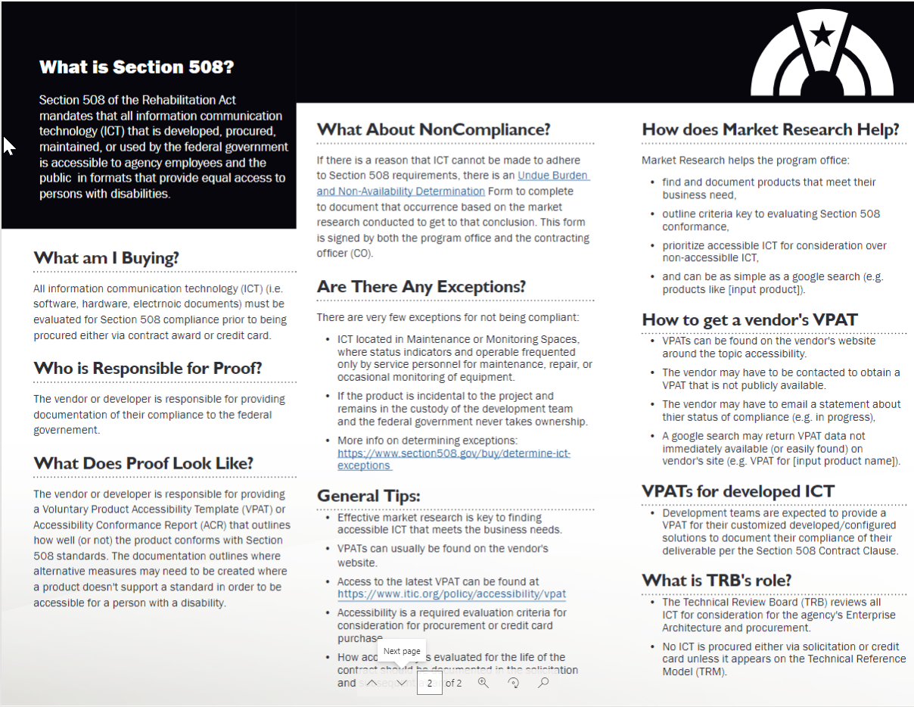
WIIFM – What’s In It For Me?
Brochure for Procurement Audience

Slide 10
Accessibility Acknowledgment
Accepting that accessibility is important, and
Understanding its impact and the way they work
Examples of Targeted Areas of Impact:
Accessibility and Reasonable Accommodations
Accessibility and Security and Privacy Initiatives
Accessibility and Training Curriculum
Accessibility and Diversity, Equity, and Inclusion
Accessibility and Acquisitions – Contracts & Credit Card
Accessibility and Development Teams
Notes:
Being aware of accessibility is not the same as acknowledging it.
For example, we can be aware of the speed limit on the road or highway – but that’s be honest – we don’t always acknowledge it.
We see it (sometimes) but we don’t always change our speed (i.e., slow down) – we just hope we don’t get caught.

Slide 11
Accessibility Advocacy* – Ally in Messaging
Helping and encouraging others to adhere to the idea of accessibility
Accessibility Ambassadors
Remind people of the importance of accessibility
Recommend people attend training
Suggest coordinating with the Section 508 Compliance Team
Support Updating Policy, Procedures, and Directives
We Support You…See this is what we said
Notes:
This stage of accessibility is very helpful and it’s representative of people OTHER than the Section 508 Compliance team carrying the message.
Their support could be verbal – during meetings
Their support could be in writing – via updated processes and procedures – advocating for the importance.
Note – everything that’s being advocated in this stage doesn’t mean that the advocate knows how to do the activities recommended. It’s a reminder that people need to do it and get help if they need it.

Slide 12
Accessibility Adaption – Changing The Way We Work
Starting to change individual behavior about accessibility
We Know it’s Important Now How Do We…
Create our Documents to be Accessible
Structed and Written with Plain Language
Ensure Creative Presentations are Accessible
Make PDFs that are Accessible and Secure
Ask Vendors about their Accessibility stance
Notes:
https://www.section508.gov/tools/playbooks/technology-accessibility-playbook-intro/
Catching People in person vs Virtual options
Being more strategic and deliberate – less chance for accidental meetings

Slide 13
Accessibility Adoption – New Habits
Changed behaviors become habits when considering accessibility
The concept becomes almost second nature; it’s routine
Example of Evidence of New Habits
Number of Section 508 Complaints Reduced
Communications Team receiving better content to publish
Section 508 Team members being invited to participate in Integrated Project Teams and Projects

Slide 14
Advocacy* – Ally in Applying
Demonstrating “how to” apply better behaviors regarding accessibility
Walking through features like the Accessibility Checker
Directing users to resources that are available
Internal Section 508 Resources
Checklists
Repository
We Support You…See this is what we did
Notes:
This is the phase where allies aren’t necessarily directing a user to a member of the Section 508 Compliance Team, they’re showing their co-worker directly what it is that they need to do – Either from member or accessing the tools/resource information and walking through it with them.
So, they can 1) learn how to do it themselves and 2) be exposed to the resources that are available to go back to if they need to refresh their memory when their co-worker isn’t there because they may not want to reach out the 508 Team.
So, in addition to an ally “telling” someone that they need to be mindful of accessibility – they are able to “show you” what it means use accessibility in their daily work.

Slide 15
Phases of Advancing Accessibility - Process
Note: Advocacy can apply in two different ways
Awareness
Acknowledgment
Advocacy - Adhere
Adaption
Adoption
Advocacy - Apply
Notes:
This is a recap of the items already discussed. This will the next slide after the Zoom Summary Slide for the last Advocacy.

Slide 16
Questions?
?

